Slide 1

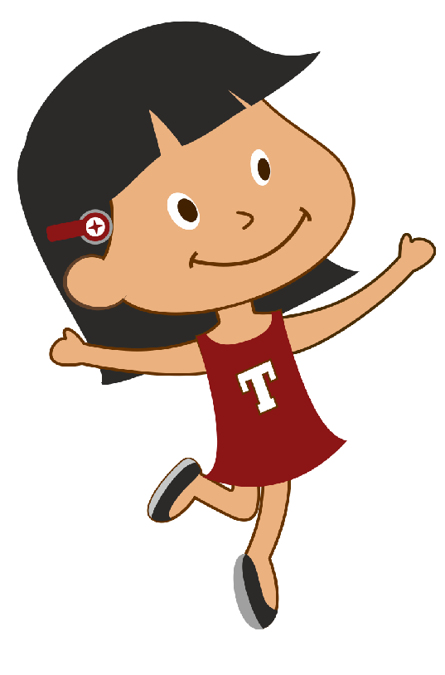


<Insert Header>
Hi I am tina
When I look up in the sky, I see so many things.
Can you help me learn what we can see in the sky ?
Click on the play button to get started.
In The Sky
Instructions
When child mouses over the button, GROW hover effect must be effected. As per below.
http://ianlunn.github.io/Hover/
PLAY

Slide 2
<Insert Header>
Instructions
When child mouses over the button, GROW hover effect must be effected. As per below.
http://ianlunn.github.io/Hover/
Sun
NEXT

Slide 3
<Insert Header>
Clouds
NEXT

Slide 4
<Insert Header>
Moon
NEXT

Slide 5

<Insert Header>
Stars
NEXT

Slide 6
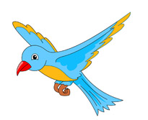
<Insert Header>
Birds
NEXT

Slide 7

<Insert Header>
Aeroplane
NEXT

Slide 8

<Insert Header>
Helicopter
NEXT

Slide 9

<Insert Header>
Rocket
NEXT

Slide 10
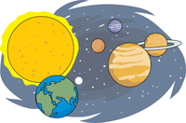
<Insert Header>
Planets
NEXT

Slide 11
<Insert Header>
Hi I am tina
When I look up in the sky, I see so many things.
Can you help me learn what we can see in the sky ?
Click on the play button to get started.
PLAY

Slide 12
<Insert Header>
Create game like this for
All items from 2 - 10
Instructions
When child mouses over the button, GROW hover effect must be effected. As per below.
http://ianlunn.github.io/Hover/
Select the sun.

Slide 13
Instructions for game questions
Make questions like the one above for all items taught in this lesson.

Slide 14
Audio
You have completed this activity. You are awesome!
<Insert Header>
After message is played, take child to main child dashabord

